Slide 1
Chapter 6: Empirical Estimates of Reliability
We have seen that reliability of a test is a theoretical concept and can not be computed directly. It can only be estimated by constructing two parallel tests.
In this chapter we will discuss ways to estimate reliability
Three methods of estimating reliability
alternate forms/parallel forms
test-retest method
internal consistency (most common)
Each of these methods yield different estimates of reliability coefficient.

Slide 2
Parallel tests
The two tests measure the same construct.
The tests are administered to the same sample of individuals.
The observed scores on the two tests have the same mean.
The observed scores on the two tests have the same standard deviation.
In reality it is very difficult to construct strictly parallel tests.
We can never be sure that they measure the same psychological attribute (true score) because they contain different content/items.
Potential carry-over effects due to repeated testing could cause error scores to be correlated.

Slide 3
Alternate forms/parallel forms reliability
However we can construct two alternate forms that measure the same attribute, and if they have same observed means and SDs, then their correlation is an estimate of the reliability of both tests.
In obtaining scores for alternate forms one has to pay attention to the time interval between testings. Potential problems include:
learning between occasions
memory/carry over effects
correlated errors
Table 6.1 illustrates potential problem of correlated error scores with using alternate forms for estimating reliability.

Slide 4
Test-Retest Reliability
The test administered to same individuals on more than one occasion (twice). The correlation between test scores on two occasions is an estimate of reliability.
This approach has same problems like before:
learning between occasions
memory/carry over effects
correlated errors

Slide 5
Internal Consistency Reliability
Most widely used.
A single form of test administered once to a group of individuals.
Here one is not interested in stability or consistency of scores over time, but consistency of items/parts within the test.
Split-half reliability estimate: consistency among the parts of a test
Idea: If test parts are strongly correlated, then the test is likely to be reliable.
The test is administered once to a group of individuals
Divide the test into two subtests

Slide 6
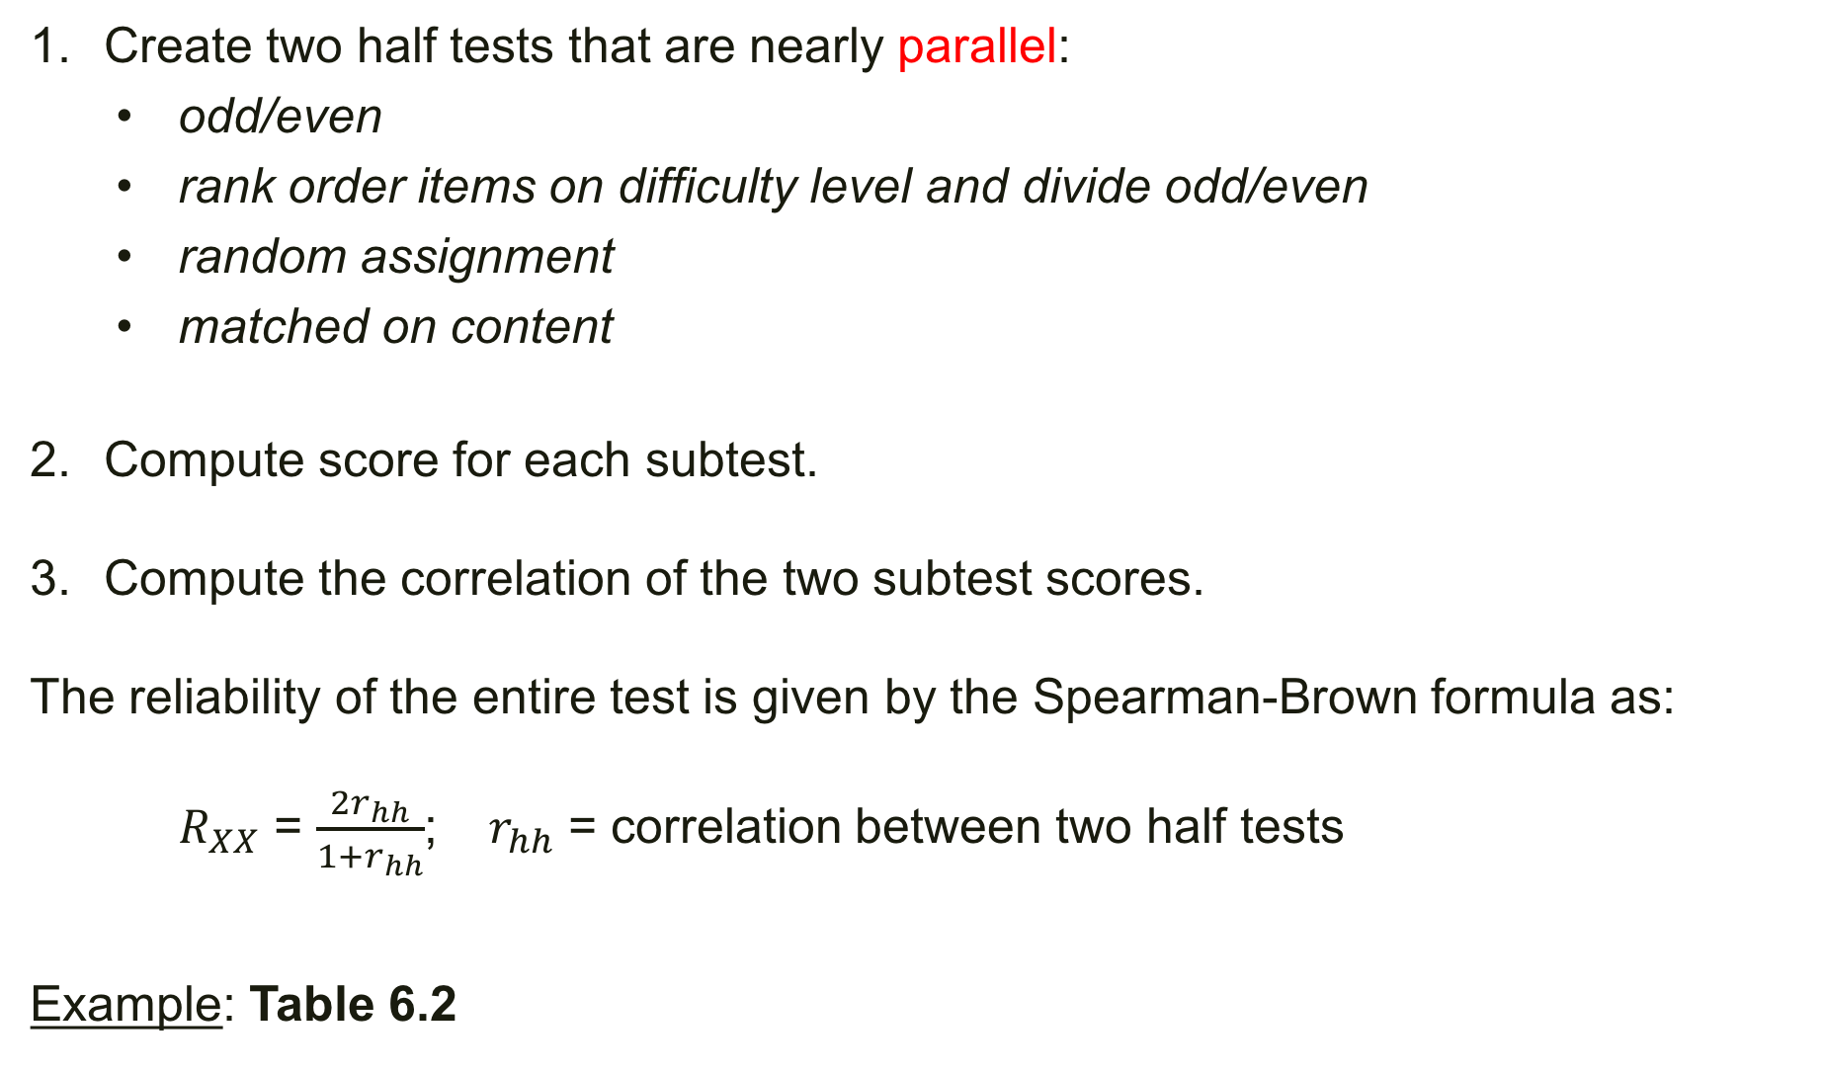
Create two half tests that are nearly parallel:
odd/even
rank order items on difficulty level and divide odd/even
random assignment
matched on content
Compute score for each subtest.
Compute the correlation of the two subtest scores.
The reliability of the entire test is given by the Spearman-Brown formula as:
$R_{XX}$ = $\frac{2r_{hh}}{1+r_{hh}}$; $r_{hh}$ = correlation between two half tests
Example: Table 6.2
Notes:
Odd/even item split lead to a reliability of .43; while creating halves by items 1&4 vs 2&3 lead to reliability of .94. There is no unique way of splitting a test into two that produces the most accurate estimate of reliability. For this reason this is not commonly used.

Slide 7

Table 6.2
Split-Half 1
$r_{hh}$ = 0.276
$R_{XX}$ = $\frac{2(0.276)}{1+0.276} =0.433$
Split-Half 2
$r_{hh}$ = 0.89
$R_{XX}$ = $\frac{2(0.89)}{1+0.89} =0.94$
 | ‘Odd’ subtest | ‘even’ subtest
 | 9 | 8
 | 9 | 7
 | 7 | 7
 | 3 | 4
Mean | 7 | 5.75
Variance | 6 | 2.19
 | Subtests 1 & 4 | Subtests 2 & 3
 | 8 | 9
 | 7 | 6
 | 7 | 6
 | 4 | 4
Mean | 6.5 | 6.25
Variance | 2.25 | 3.19

Slide 8
Speed tests and Power tests
Speed tests:
time-limit tests
not expected that examinees will complete the test
items are of comparable difficulty level
attempted items will be correctly answered
Power tests:
Adequate time allowed to complete the test
items range in difficulty level
expected that examinees will answer all questions
Split-half reliability of speeded tests: will be close to 1; Items are of equal difficulty and hence the same chance of correct response.
Notes:
Odd/even item split lead to a reliability of .43; while creating halves by items 1&4 vs 2&3 lead to reliability of .94. There is no unique way of splitting a test into two that produces the most accurate estimate of reliability. For this reason this is not commonly used.

Slide 9
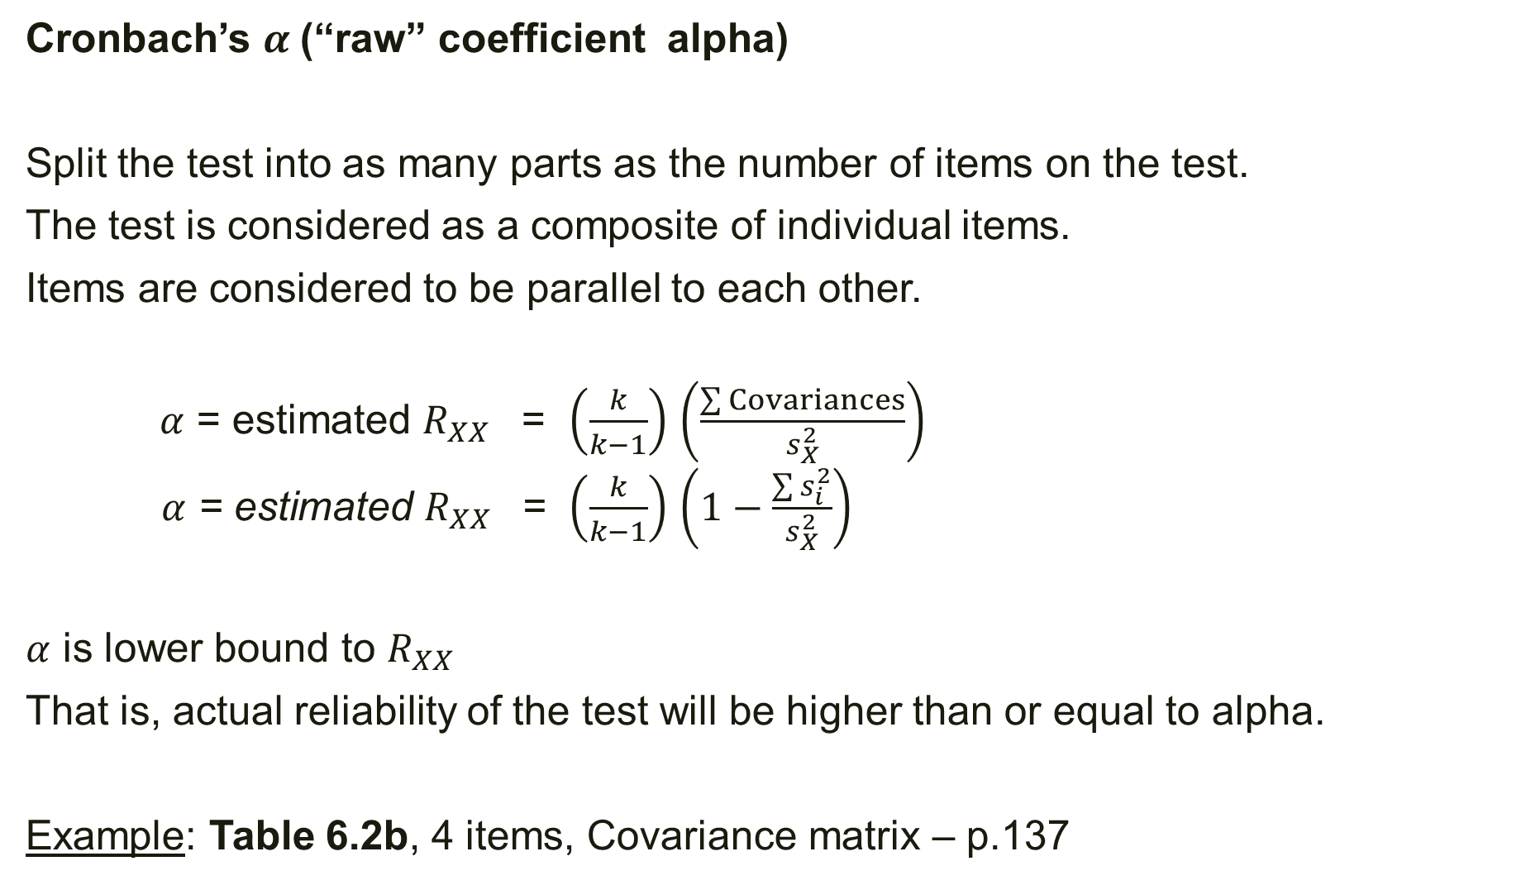
Cronbach’s $α$(“raw” coefficient alpha)
Split the test into as many parts as the number of items on the test.
The test is considered as a composite of individual items.
Items are considered to be parallel to each other.
$α$ = estimated $R_{XX}$ = $\left(\frac{k}{k−1}\right)$ $\left(\frac{\sum{Covariances}}{s_{X}^{2}}\right)$
$α$ = estimated $R_{XX}$ = $\left(\frac{k}{k−1}\right)$ $\left(1−\frac{\sum{s_{i}^{2}}}{s_{X}^{2}}\right)$
$α$ is lower bound to $R_{XX}$
That is, actual reliability of the test will be higher than or equal to alpha.
Example: Table 6.2b, 4 items, Covariance matrix – p.137
Notes:
Odd/even item split lead to a reliability of .43; while creating halves by items 1&4 vs 2&3 lead to reliability of .94. There is no unique way of splitting a test into two that produces the most accurate estimate of reliability. For this reason this is not commonly used.

Slide 10
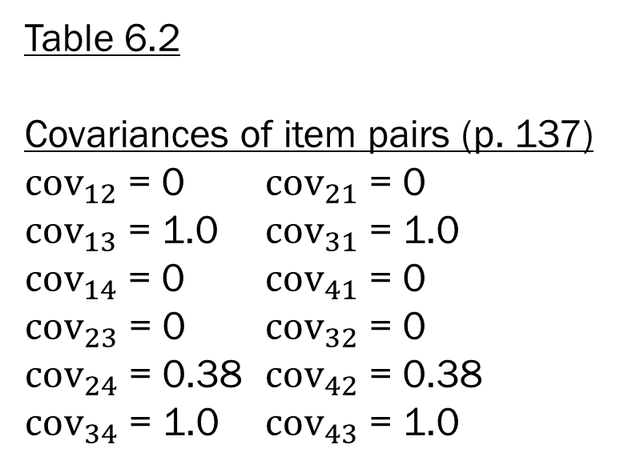
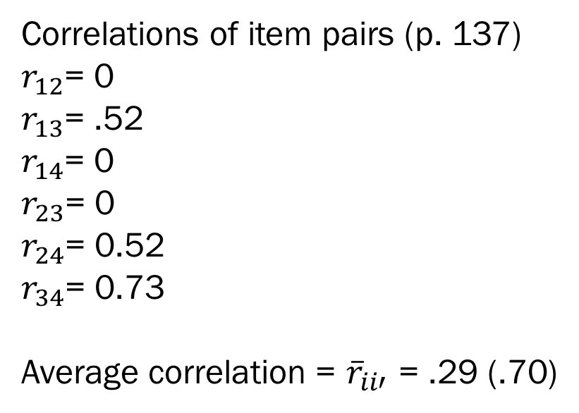
Table 6.2
Covariances of item pairs (p. 137)
${cov}_{12}$ = 0 ${cov}_{21}$ = 0
${cov}_{13}$ = 1.0 ${cov}_{31}$ = 1.0
${cov}_{14}$ = 0 ${cov}_{41}$ = 0
${cov}_{23}$ = 0 ${cov}_{32}$ = 0
${cov}_{24}$ = 0.38 ${cov}_{42}$ = 0.38
${cov}_{34}$ = 1.0 ${cov}_{43}$ = 1.0
Correlations of item pairs (p. 137)
$r_{12}$= 0
$r_{13}$= .52
$r_{14}$= 0
$r_{23}$= 0
$r_{24}$= 0.52
$r_{34}$= 0.73
Average correlation = ${\overline{r}}_{ii′}$ = .29 (.70)

Slide 11
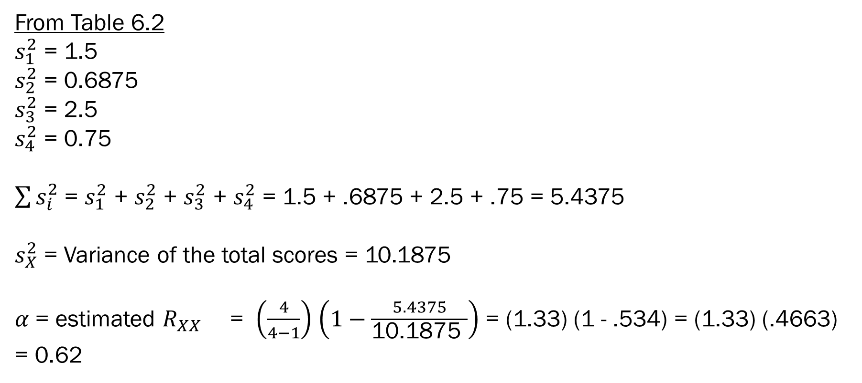
From Table 6.2
$s_{1}^{2}$ = 1.5
$s_{2}^{2}$ = 0.6875
$s_{3}^{2}$ = 2.5
$s_{4}^{2}$ = 0.75
$\sum{s_{i}^{2}}$ = $s_{1}^{2}$ + $s_{2}^{2}$ + $s_{3}^{2}$ + $s_{4}^{2}$ = 1.5 + .6875 + 2.5 + .75 = 5.4375
$s_{X}^{2}$ = Variance of the total scores = 10.1875
$α$ = estimated $R_{XX}$ = $\left(\frac{4}{4−1}\right)$ $\left(1−\frac{5.4375}{\text{10.1875 }}\right)$ = (1.33) (1 - .534) = (1.33) (.4663) = 0.62

Slide 12

“Standardized” Coefficient Alpha
Each item is standardized (z-score) before computing the coefficient alpha as:
$R_{XX}$ = $\frac{k{\overline{r}}_{ii′}}{1+(k−1){\overline{r}}_{ii′}}$;
Example: data in Table 6.2; pp 140-141
Notes:
Odd/even item split lead to a reliability of .43; while creating halves by items 1&4 vs 2&3 lead to reliability of .94. There is no unique way of splitting a test into two that produces the most accurate estimate of reliability. For this reason this is not commonly used.
Items with larger variance have greater weight on the total score. In Table 6.2, item 3 has the largest variance (2.5), while item 2 has the smallest variance (069), resulting in higher correlation between item 3 and the total test (.89) than item 2 (.40).

Slide 13
The standardized alpha is appropriate when test score is created by aggregating from different items (tests).
Examples:
When items vary widely in their variance. Items with larger variance have greater weight on the total score.
If items have different response scales (some items on a 7-point scale while others on a 5-point scale)
If scores from different measures are combined to form a new composite score, such as GPA and SAT scores.

Slide 14
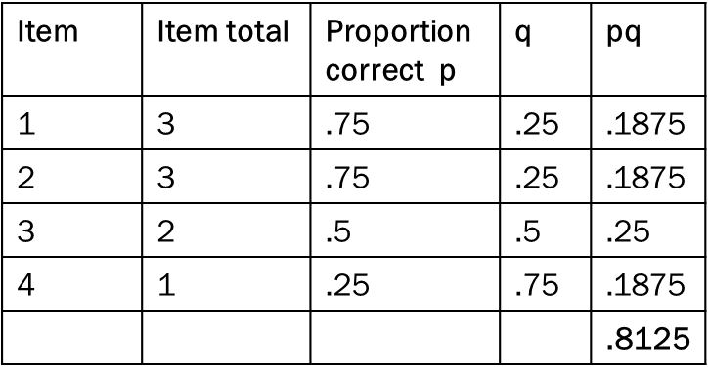
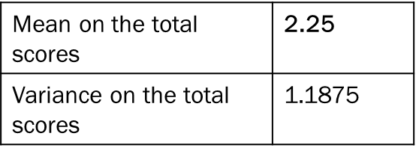
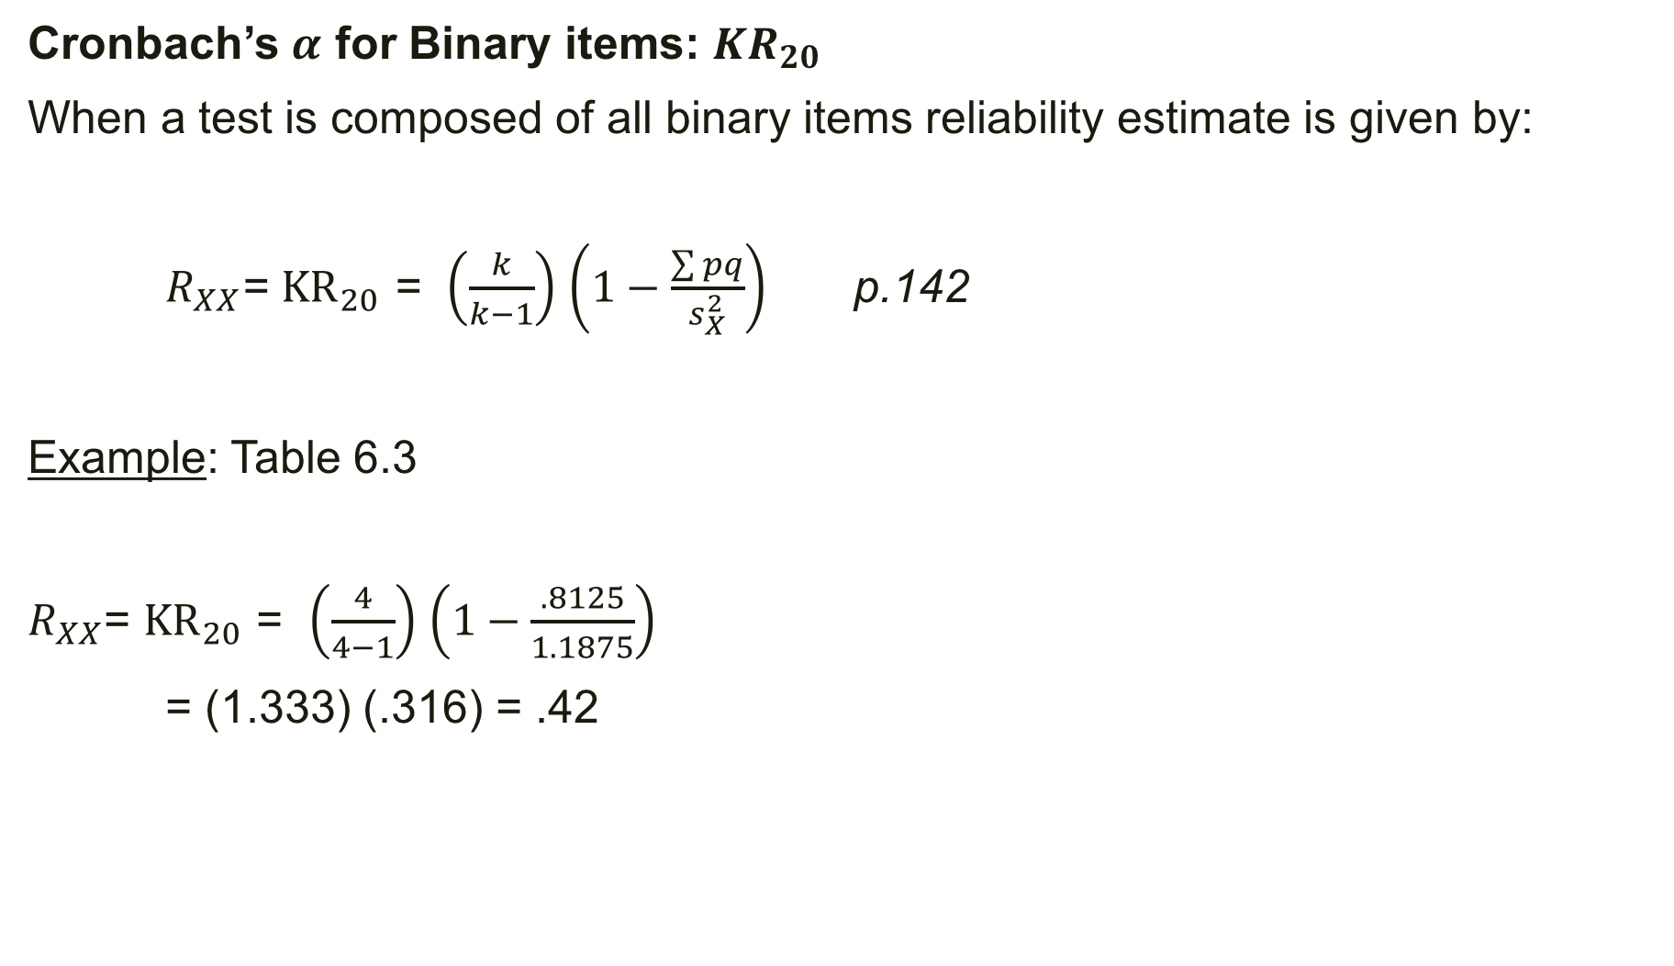
Cronbach’s $α$ for Binary items: ${KR}_{20}$
When a test is composed of all binary items reliability estimate is given by:
$R_{XX}$= ${KR}_{20}$ = $\left(\frac{k}{k−1}\right)$ $\left(1−\frac{\sum{pq}}{s_{X}^{2}}\right)$ p.142
Example: Table 6.3
$R_{XX}$= ${KR}_{20}$ = $\left(\frac{4}{4−1}\right)$ $\left(1−\frac{.8125}{1.1875}\right)$
= (1.333) (.316) = .42
Person | Total score
1 | 4
2 | 2
3 | 2
4 | 1

Slide 15
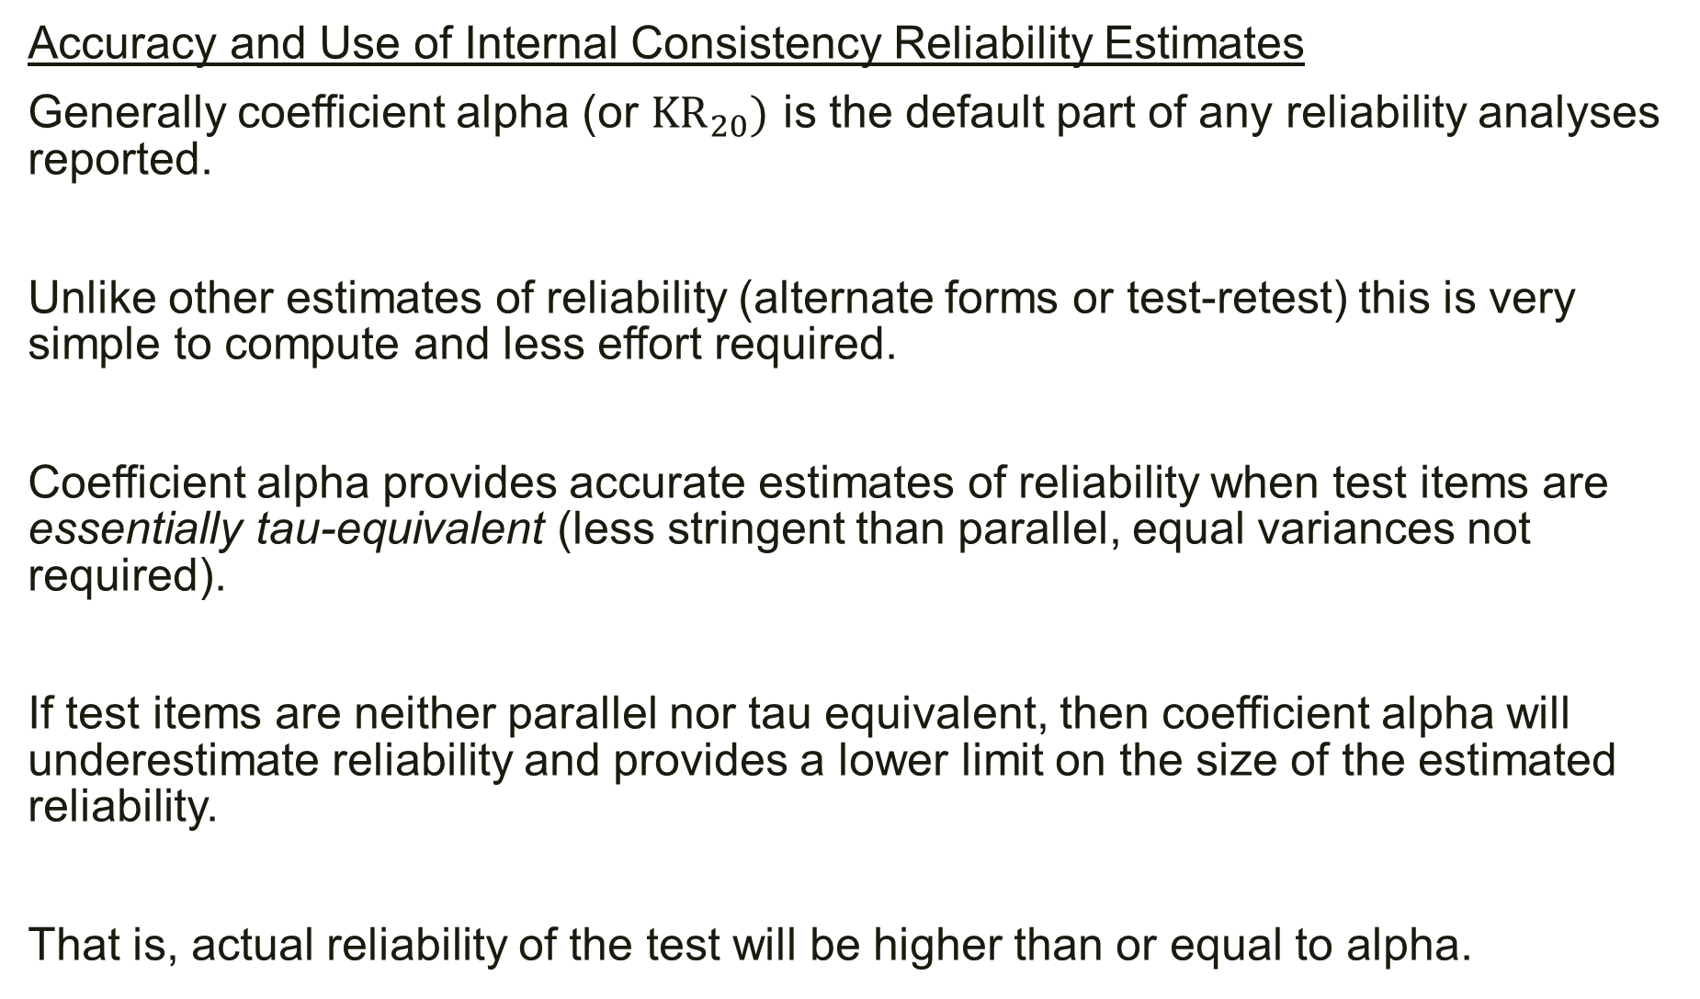
Accuracy and Use of Internal Consistency Reliability Estimates
Generally coefficient alpha (or ${KR}_{20})$ is the default part of any reliability analyses reported.
Unlike other estimates of reliability (alternate forms or test-retest) this is very simple to compute and less effort required.
Coefficient alpha provides accurate estimates of reliability when test items are essentially tau-equivalent (less stringent than parallel, equal variances not required).
If test items are neither parallel nor tau equivalent, then coefficient alpha will underestimate reliability and provides a lower limit on the size of the estimated reliability.
That is, actual reliability of the test will be higher than or equal to alpha.

Slide 16
Internal Consistency versus Dimensionality
High internal consistency does not imply that test items are unidimensional (or conceptually homogeneous).
This is because, a test’s internal consistency could be high even if the test is multidimensional.
Example: A composite test might include two sets of items where items within the set are internally consistent with strong correlations while items between the sets are weakly correlated.

Slide 17
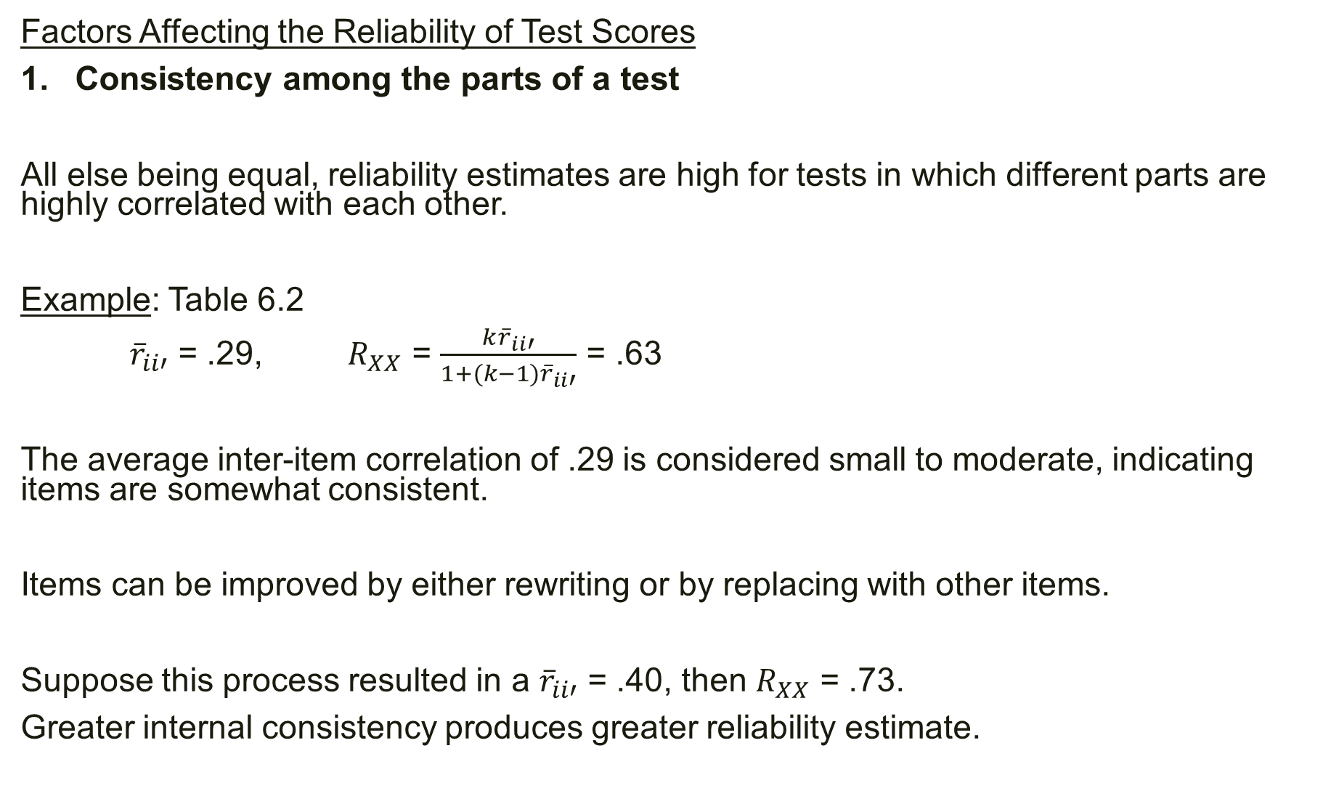
Factors Affecting the Reliability of Test Scores
Consistency among the parts of a test
All else being equal, reliability estimates are high for tests in which different parts are highly correlated with each other.
Example: Table 6.2
${\overline{r}}_{ii′}$ = .29, $R_{XX}$ = $\frac{k{\overline{r}}_{ii′}}{1+(k−1){\overline{r}}_{ii′}}$ = .63
The average inter-item correlation of .29 is considered small to moderate, indicating items are somewhat consistent.
Items can be improved by either rewriting or by replacing with other items.
Suppose this process resulted in a ${\overline{r}}_{ii′}$ = .40, then $R_{XX}$ = .73.
Greater internal consistency produces greater reliability estimate.

Slide 18
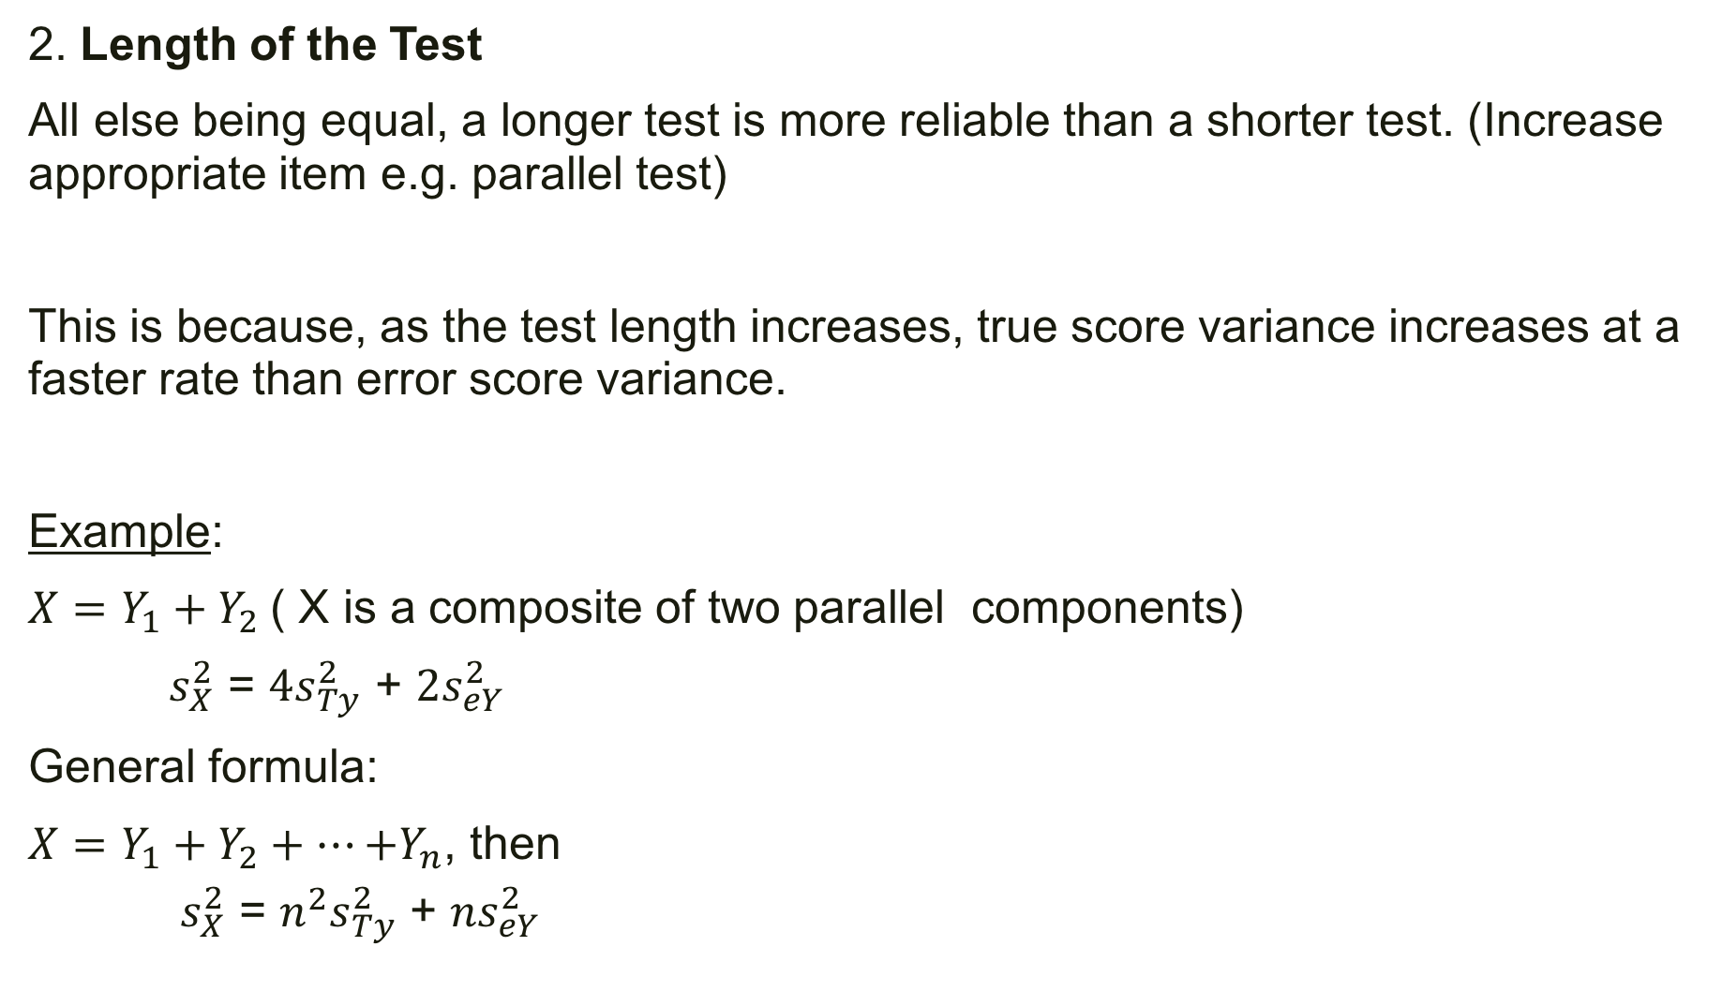
2. Length of the Test
All else being equal, a longer test is more reliable than a shorter test. (Increase appropriate item e.g. parallel test)
This is because, as the test length increases, true score variance increases at a faster rate than error score variance.
Example:
$X=Y_{1}+Y_{2}$( X is a composite of two parallel components)
$s_{X}^{2}$ = ${4s}_{Ty}^{2}$ + ${2s}_{eY}^{2}$
General formula:
$X=Y_{1}+Y_{2}+⋯{+Y}_{n}$, then
$s_{X}^{2}$ = ${n^{2}s}_{Ty}^{2}$ + ${ns}_{eY}^{2}$

Slide 19
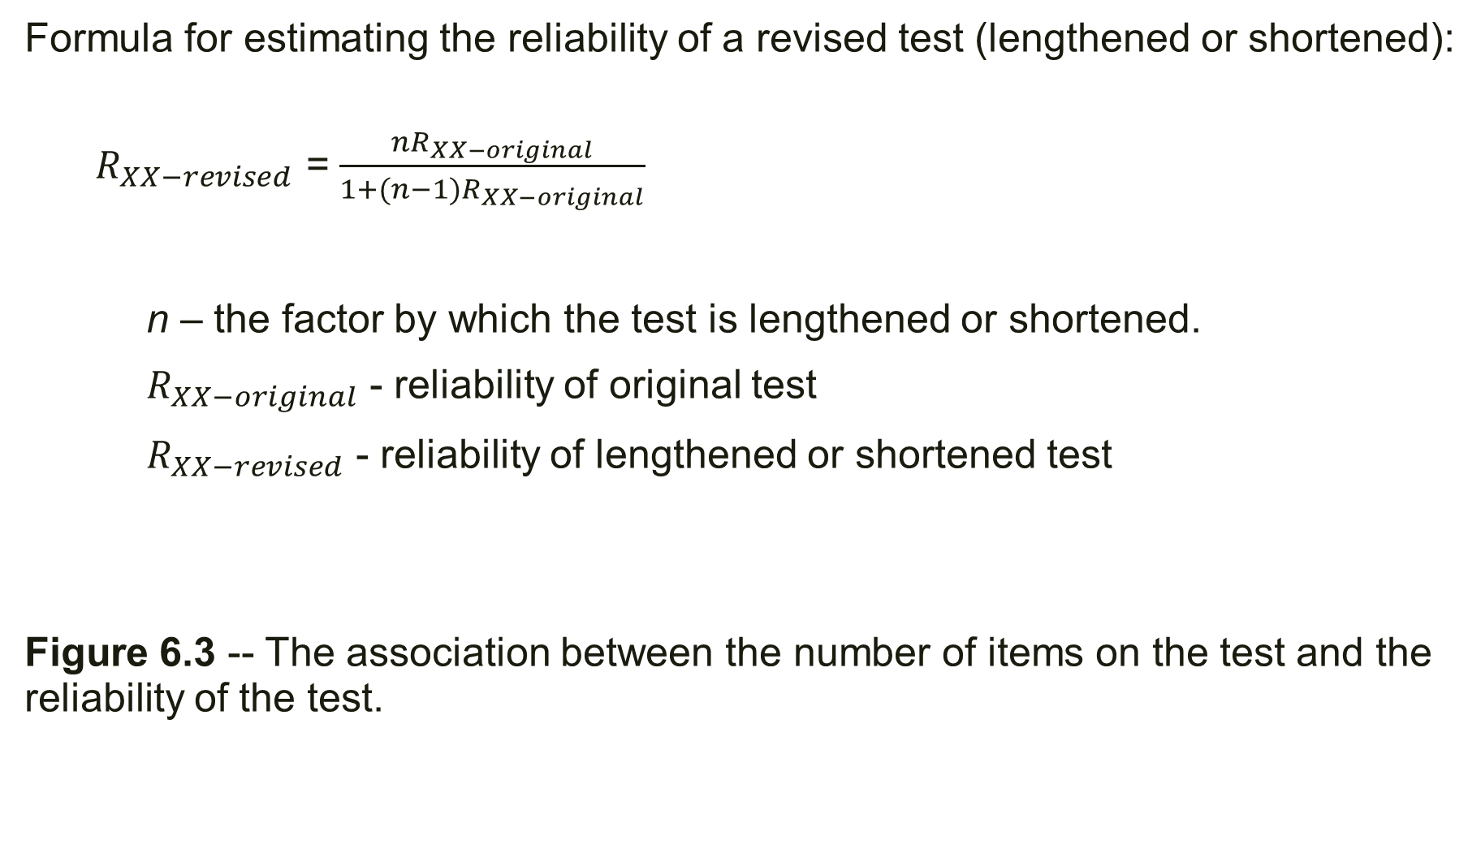
Formula for estimating the reliability of a revised test (lengthened or shortened):
$R_{XX−revised}$ = $\frac{nR_{XX−original}}{1+(n−1)R_{XX−original}}$
n – the factor by which the test is lengthened or shortened.
$R_{XX−original}$ - reliability of original test
$R_{XX−revised}$ - reliability of lengthened or shortened test
Figure 6.3 -- The association between the number of items on the test and the reliability of the test.

Slide 20
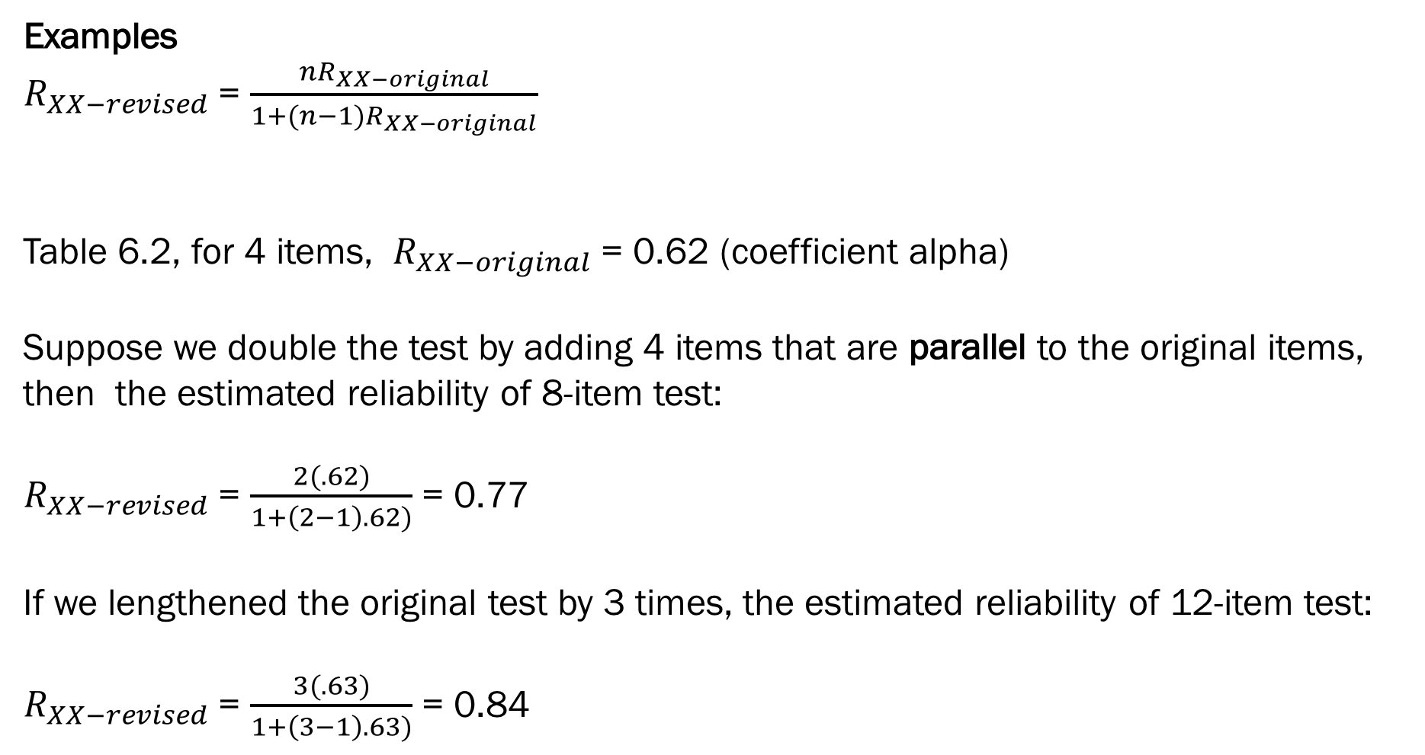
Examples
$R_{XX−revised}$ = $\frac{nR_{XX−original}}{1+(n−1)R_{XX−original}}$
Table 6.2, for 4 items, $R_{XX−original}$ = 0.62 (coefficient alpha)
Suppose we double the test by adding 4 items that are parallel to the original items, then the estimated reliability of 8-item test:
$R_{XX−revised}$ = $\frac{2(.62)}{1+\left(2−1\right).62)}$ = 0.77
If we lengthened the original test by 3 times, the estimated reliability of 12-item test:
$R_{XX−revised}$ = $\frac{3(.63)}{1+\left(3−1\right).63)}$ = 0.84

Slide 21
3. Sample homogeneity/heterogeneity and Reliability
All else being equal, greater the variability among people with respect to their trait being measured, the larger the reliability coefficient.
This means that reliability is not characteristic of just the test items, but also the individuals in the sample. Therefore a test can produce higher reliability estimates in one sample, but less value in a different sample.
Reliability generalization studies are done to understand the degree to which a test produces differing reliability estimates across different kinds of research use and populations.

Slide 22
Example
Vacha-Haase, Kogan, Tani, and Woodall (2001) conducted a reliability generalization study of the MMPI.
They examined more than 150 studies that used the MMPI clinical scales and had reported reliability estimates based on the data.
Results revealed that most of the MMPI scales generally produced acceptable reliability, but reliability varied across studies.
For many of the MMPI scales, scores were more reliable for adult samples than adolescent samples; and for clinical samples (as opposed to nonclinical samples).
In this way one can understand how sample characteristics affect reliability of test scores.

Slide 23
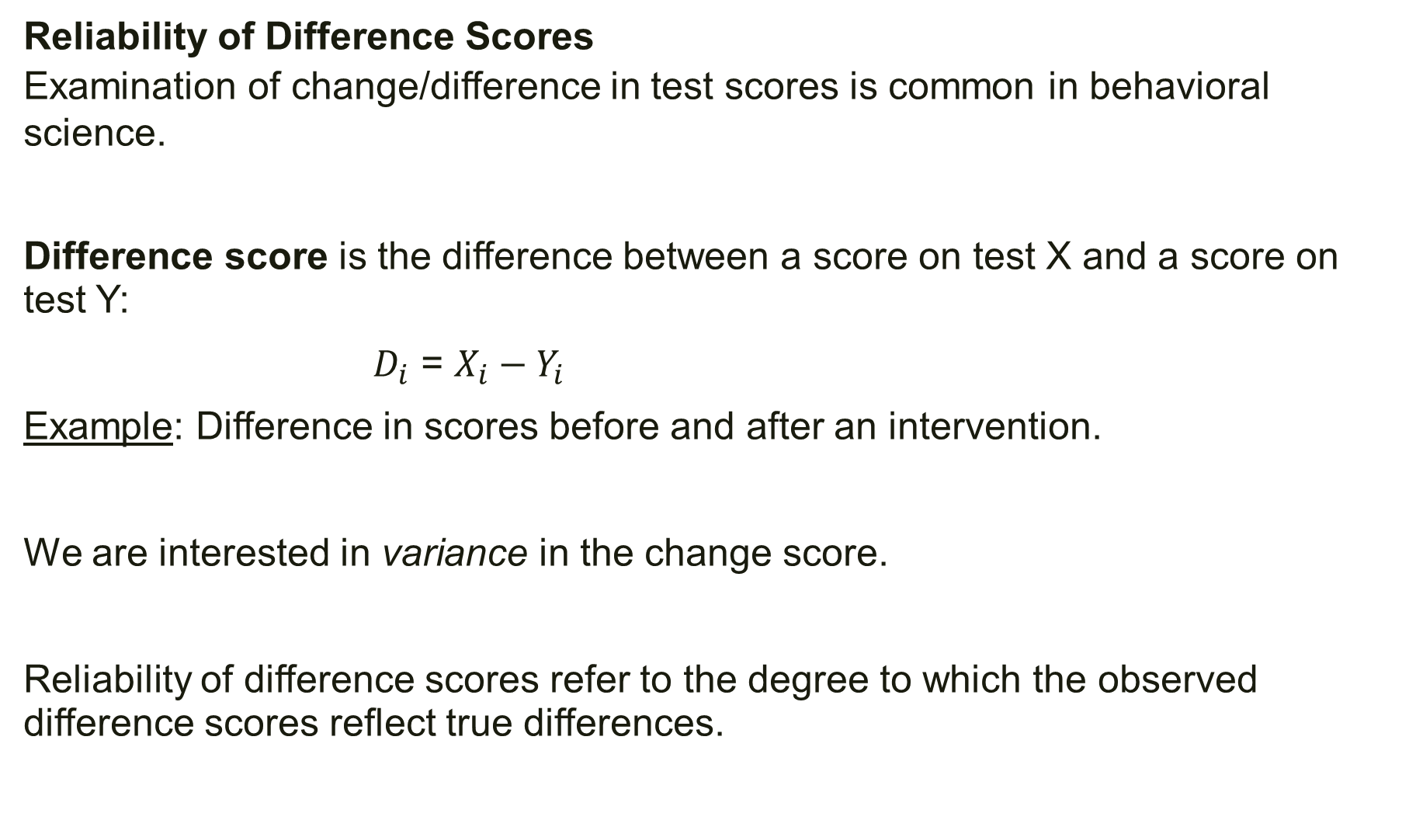
Reliability of Difference Scores
Examination of change/difference in test scores is common in behavioral
science.
Difference score is the difference between a score on test X and a score on test Y:
$D_{i}$ = $X_{i}−Y_{i}$
Example: Difference in scores before and after an intervention.
We are interested in variance in the change score.
Reliability of difference scores refer to the degree to which the observed difference scores reflect true differences.

Slide 24
There are several types of difference scores:
Intra-individual change score: each person has two scores on the same test and the difference between the scores is computed.
Example: test score difference before and after intervention.
Intra-individual discrepancy score: each person has two scores from different tests and the difference between the scores is computed.
Example: discrepancy in scores between types of intelligence: verbal intelligence and perceptual reasoning.
Here we are taking about difference between attributes rather than change in single attribute.
Interindividual difference score: two different people are given the same test and the difference in scores is compute.
Example: each couple has two test scores on the same test, say personality test.

Slide 25
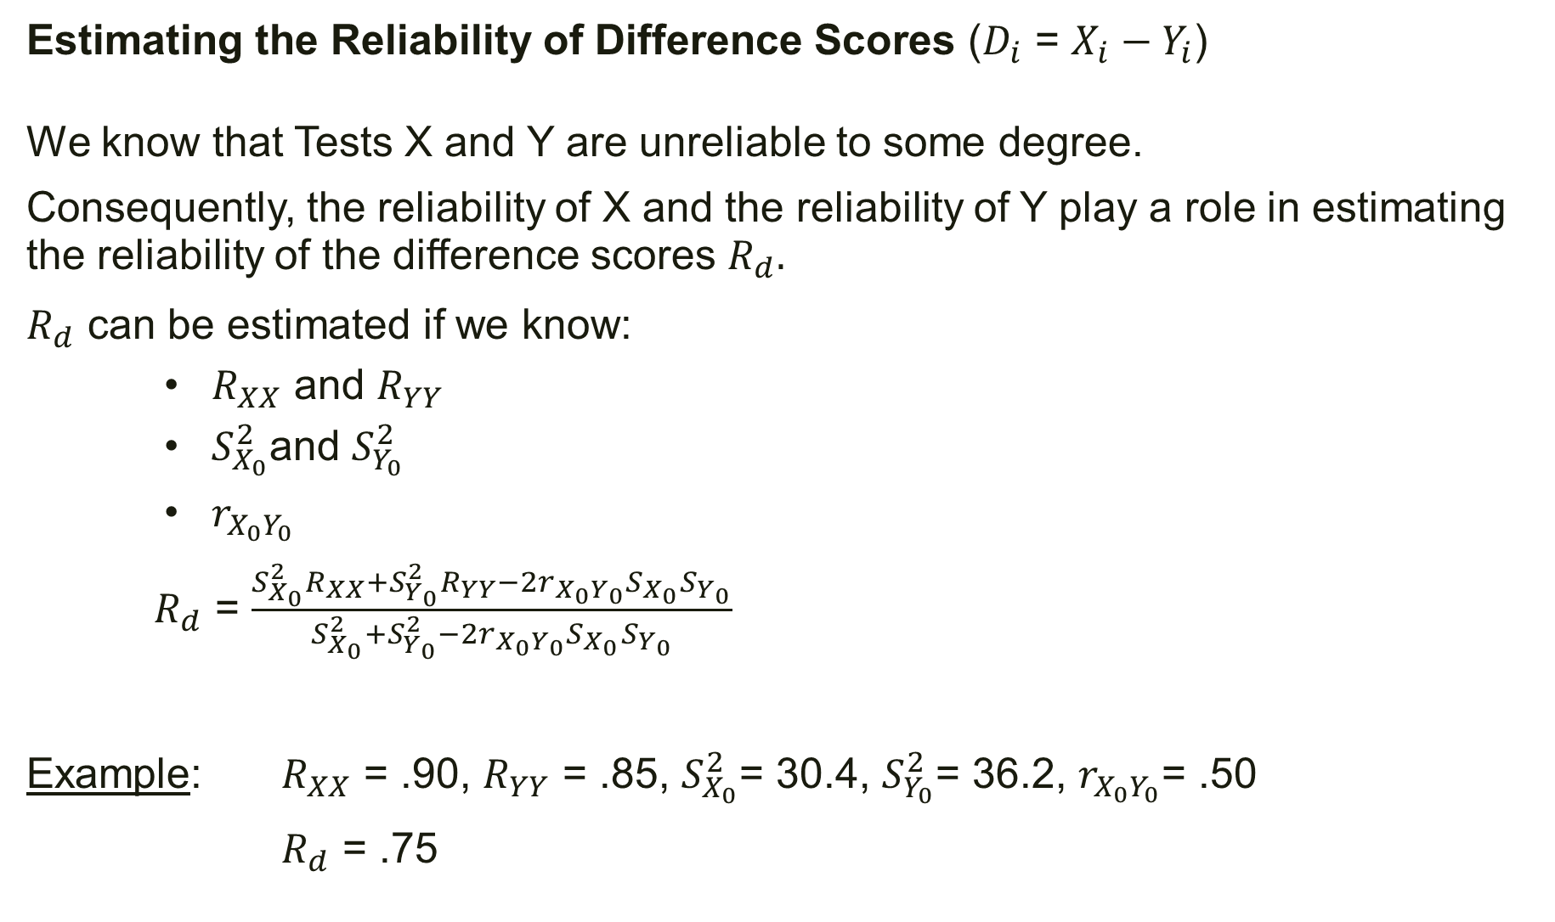
Estimating the Reliability of Difference Scores ($D_{i}$ = $X_{i}−Y_{i}$)
We know that Tests X and Y are unreliable to some degree.
Consequently, the reliability of X and the reliability of Y play a role in estimating the reliability of the difference scores $R_{d}.$
$R_{d}$ can be estimated if we know:
$R_{XX}$ and $R_{YY}$
$S_{X_{0}}^{2}$and $S_{Y_{0}}^{2}$
$r_{X_{0}Y_{0}}$
$R_{d}$ = $\frac{S_{X_{0}}^{2}R_{XX}+S_{Y_{0}}^{2}R_{YY}−2r_{X_{0}Y_{0}}S_{X_{0}}S_{Y_{0}}}{S_{X_{0}}^{2}+S_{Y_{0}}^{2}−2r_{X_{0}Y_{0}}S_{X_{0}}S_{Y_{0}}}$
Example: $R_{XX}$ = .90, $R_{YY}$ = .85, $S_{X_{0}}^{2}$= 30.4, $S_{Y_{0}}^{2}$= 36.2, $r_{X_{0}Y_{0}}$= .50
$R_{d}$ = .75

Slide 26
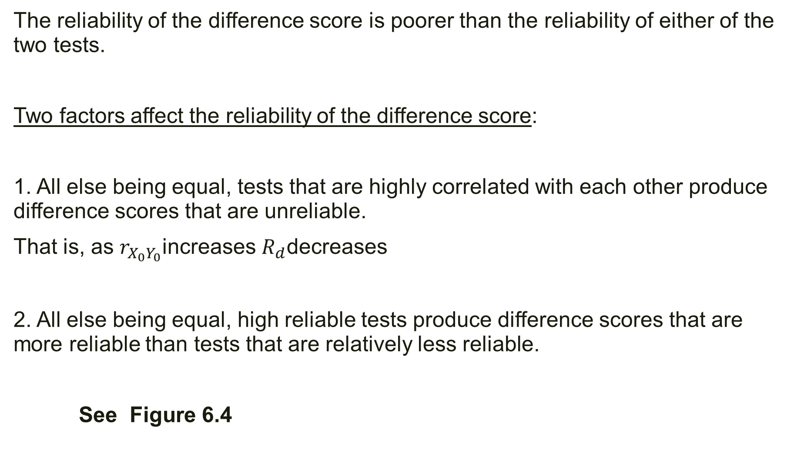
The reliability of the difference score is poorer than the reliability of either of the two tests.
Two factors affect the reliability of the difference score:
1. All else being equal, tests that are highly correlated with each other produce difference scores that are unreliable.
That is, as $r_{X_{0}Y_{0}}$increases $R_{d}$decreases
2. All else being equal, high reliable tests produce difference scores that are more reliable than tests that are relatively less reliable.
See Figure 6.4

